Slide 1

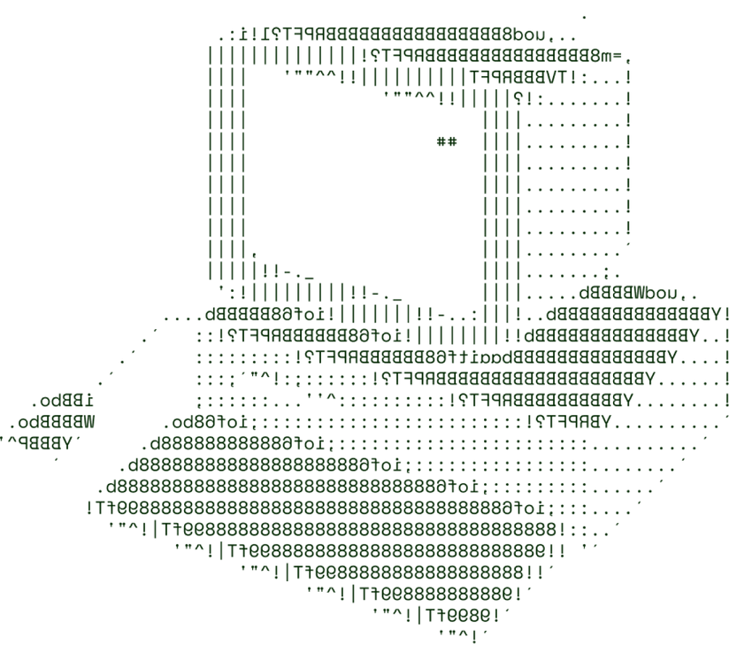


> ByteCode – A True Farmer Friend
(ByteCode)

Slide 2

What’s the Problem Statement
Develop a Solution to Forecast the Crops Price and Presumption of the Crops to be Grown In the Field
Why We Chose this Problem
We chose this problem statement to address the pressing need for accurate crop price prediction and crop recommendation. While organizations like NCDEX provide such predictions, their 57% accuracy often falls short for farmers and policymakers. Our model, achieving 86% accuracy, can better support sustainable farming and data-driven agricultural planning across diverse regions.

Slide 3
What’s Our Solution
Here we are presenting ByteCode a solution for the derived problem.
LSTM-Based Price Prediction Model Our solution employs a Long Short-Term Memory neural network trained on time-series data from 2013 to 2021 which captures temporal dependencies, seasonal trends, and market volatility, ensuring precise multi-step forecasting for commodity prices.
Real-Time Price Insights The system delivers dynamic, data-driven reports that provide real-time insights for farmers and stakeholders, helping them navigate price fluctuations with confidence.
Predictive Buffer Stock Management Using predictive analytics, we streamline buffer stock handling, optimizing supply and demand alignment in real time to minimize wastage and improve stock efficiency.
Event-Driven Market Impact Analysis We integrated NLP models to assess live news, weather, and policy changes, predicting their impact on commodity prices.
AI-Driven Crop Planting Recommendations Our AI model analyzes environmental factors like temperature, humidity, soil pH, and rainfall to recommend optimal planting times, promoting sustainable farming and maximizing crop yield

Slide 4



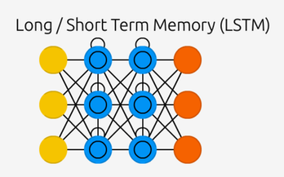



TECHNICAL ARCHITECTURE
ByteCode is a comprehensive agricultural tool integrating public and private datasets for predictive analysis. It preprocesses data for accuracy, predicts crop prices using machine learning, and recommends crops based on environmental inputs. Featuring interactive visualizations and customizable user input, ByteCode empowers farmers with data-driven, tailored recommendations to optimize yield and profitability.

Slide 5
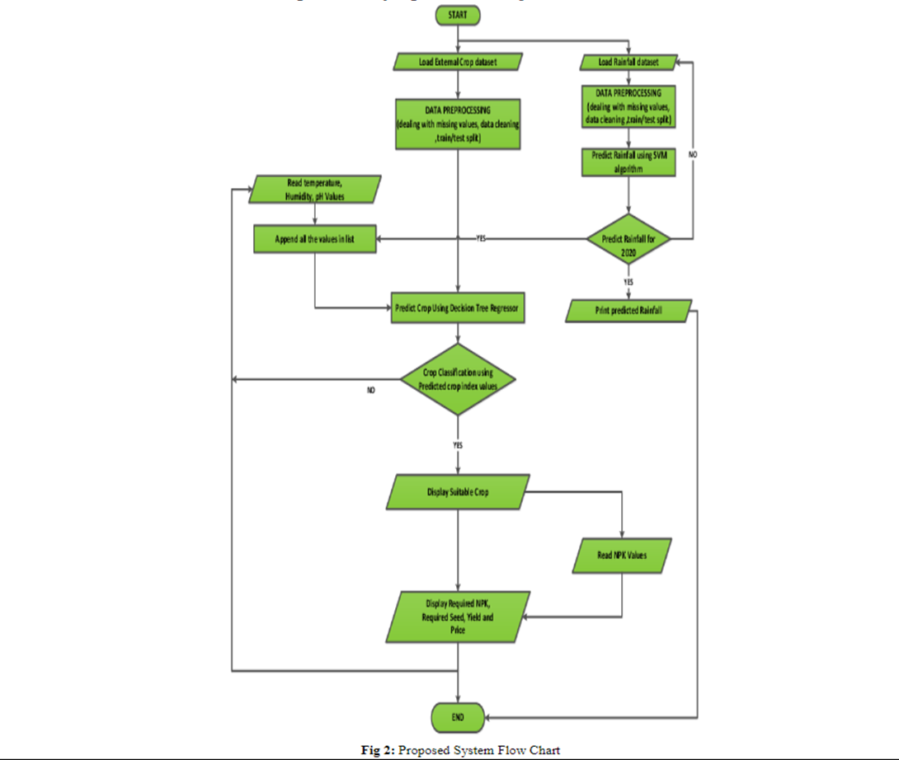
TECHNICAL ARCHITECTURE
Here We describe the project flow works and we are prdecting and building the model

Slide 6
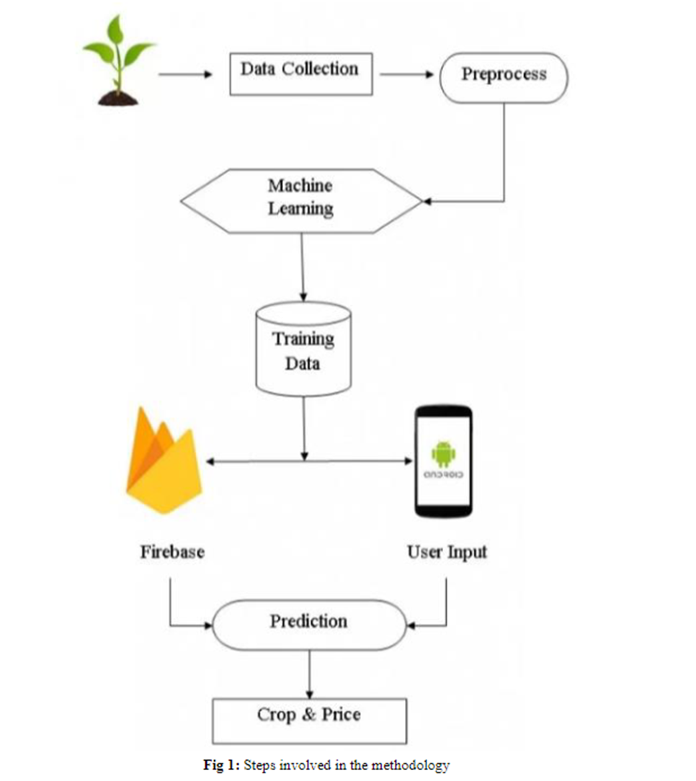
TECHNICAL ARCHITECTURE
Describing how the model has been build Up

Slide 7







FEASIBILITY AND VIABILITY
ByteCode
Greater computational capability compared to ARIMA. Smooth Flask based Web Interface. Clear market need for both producers and consumers. Accuracy of 91% which is highly efficient.
Data Quality and Model Complexity require fine tuning else it may affect accuracy. High computational costs for data collection as well as processing. Seasonality and environmental factors add to complexity.
Use of cloud based GPU/ TPU services for improving computation complexity. Beta testing to gather feedback and improve. Using time series split to ensure robust evaluation.
FEASIBILITY ANALYSIS
CHALLENGES AND RISKS
MITIGATING STRATEGIES
@SIH Idea submission- Template
4

Slide 8






>>Team Details
Gaurab, Chaudhury
Avijit, Singh
22BCE8609
22BCE7854

